Slide 1
Biol 7200: Programming for Bioinformatics Permissions, writing and using Bash scripts

Slide 2
Plan for today
Code demonstrations and discussion
File types
Permissions
Bash scripting basics

Slide 3
Plan for today
Code demonstrations and discussion
File types
Permissions
Bash scripting basics

Slide 4
Code demonstrations and discussion

Slide 5
Plan for today
Code demonstrations and discussion
File types
Permissions
Bash scripting basics

Slide 6
UnIx File System
On a UNIX system, almost everything is given a filehandle (address in the filesystem).
See the link below and this week’s reading for more details!
In UNIX Everything is a File (archive.org)
Type | Symbol | Description
Regular | - | Regular file
Directories | d | List of other files
Links | l | Links (shortcuts) to other files
Character device | c | Type of special file – serial access only
Block device | b | Type of special file – supports random access
Sockets | s | provide inter-process networking
Named pipes | p | like sockets, w/o network socket semantics
Need to know
Outside course
scope

Slide 7
Unix files can be thought of as having 3 levels
Filename lookup
Filename
inode number
inode table
inode number
Owner/group
Permissions
Etc…
Data locations …
Data blocks on hard drive
Data
Data
…

Slide 8
Files contain data as you would expect
Filename lookup
Filename
inode number
inode table
inode number
Owner/group
Permissions
Etc…
Data locations …
Data blocks on hard drive
Data
Data
…
"The quick brown fox
jumps over the lazy dog"
Data

Slide 9
Directories are files that contain a table of inodes
Filename lookup
Filename
inode number
inode table
inode number
Owner/group
Permissions
Etc…
Data locations …
Data blocks on hard drive
Data
. <self inode number>
.. <parent inode number>
file1 <file1 inode number>
etc…
Data

Slide 10
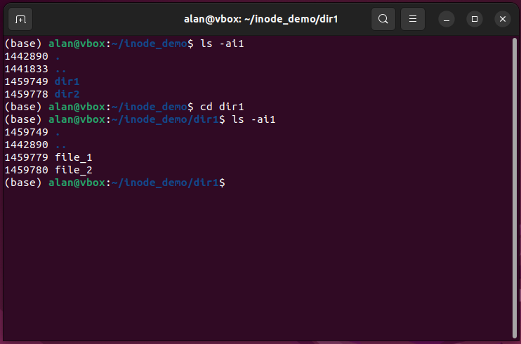
Ls –i shows inode numbers
*
*
*
*
*Note which inodes are the same!

Slide 11
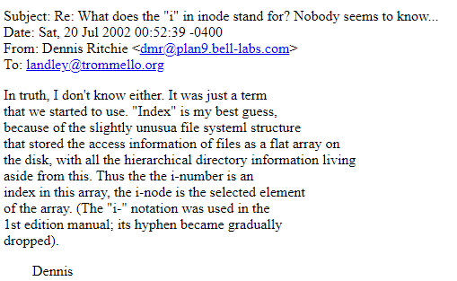
Bonus: what does the I in inode stand for?
¯\_(ツ)_/¯

Slide 12
We’ll come back to links next week

Slide 13
Plan for today
Code demonstrations and discussion
File types
Permissions
Bash scripting basics

Slide 14
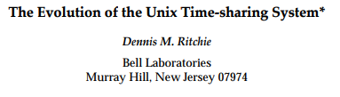
Unix is a time-sharing operating system
Time-sharing means that multiple users can use the same computer
You may not want users to be able to change each other’s files or system files
Permissions are how Unix systems allow control over user abilities

Slide 15



Permissions have three classes: User, group, other
User
Group
Others
User who owns the file
Group to which owner belongs
Other users not in owner’s group

Slide 16
Permissions have three types: read, write, execute
User
Group
Others
 | User (u) | Group (g) | Others (o)
Read
Write
Executable

Slide 17
Permissions have three types: read, write, execute
User
Group
Others
 | User (u) | Group (g) | Others (o)
Read | r | r | r
Write | w | w | -
Executable | - | - | -
Default file permissions

Slide 18
Permissions have three types: read, write, execute
User
Group
Others
 | User (u) | Group (g) | Others (o)
Read | r | r | r
Write | w | w | -
Executable | x | x | x
Default dir permissions

Slide 19
Permissions control different actions for files/dirs
Permission | Files | Directories
r | can read the file | can ls the directory
w | can write the file | can modify the directory's contents
x | can execute the file | can cd to the directory

Slide 20
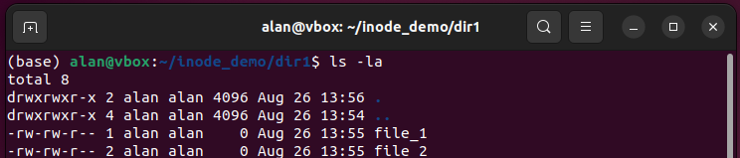
View permissions with ls -l
drwxrwxr-x
filetype
u
g
o
Permission | Files | Directories
r | can read the file | can ls the directory
w | can write the file | can modify the directory's contents
x | can execute the file | can cd to the directory

Slide 21
Chmod changes the permission mode of files
Operates in two modes:
Symbolic mode – using letters to add, remove, or set permissions
Numeric mode – using octal notation

Slide 22
Chmod symbolic mode
Mode has three components:
Who?
u – user who owns the file
g – group to which owner belongs
o – other users not in owner’s group
a – all users (default if nothing specified here)
How?
+ – add the specified permissions
- – remove the specified permissions
= – set permissions to the following
What?
r – read
w – write
x – execute
Usage of symbolic mode: chmod [<options>…] [ugoa](-|+|=)[rwx…][,…]
e.g., chmod ug+rw,o=r <file> adds read and write for user and group, sets read-only for other

Slide 23
octal notation treats permissions as binary string
Binary is a base 2 counting system – each “bit” can be 0 or 1
Number of states a binary string can represent is 2^{N}.
E.g., N=2 has 4 states: 00, 01, 10, 11
4 states means you can count to 4 using it: 00 = 1, 01 = 2, 10 = 3, 11 = 4
If counting in starting at 0, you count to 3 (but still 4 states!)
Each permission scope can either have or not have r, w, and x. Binary!
--- = 000 = 0*2² + 0*2¹ + 0*2⁰ = 0
r-x = 101 = 1*2² + 0*2¹ + 1*2⁰ = 5
rwx = 111 = 1*2² + 1*2¹ + 1*2⁰ = 7
3 bits has 8 states so it is called octal.
3 scopes (user, group, other) can be set with 3 octal numbers
Usage of numeric mode: chmod [<options>…] <octal mode>
e.g., chmod 664 <file> sets read and write for user and group, sets read for other

Slide 24
Plan for today
Code demonstrations and discussion
File types
Permissions
Bash scripting basics

Slide 25
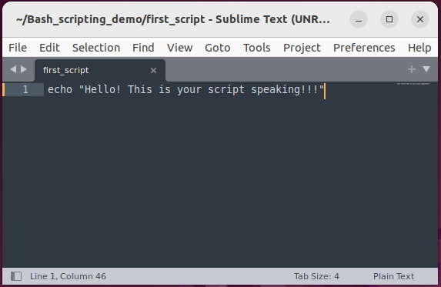
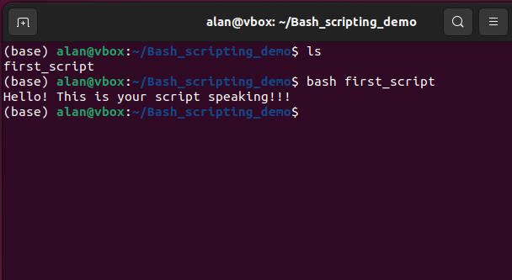
Bash scripts are files containing valid bash commands
Put any command you issued so far in a file and that file is now a Bash script
Each line of the file is a separate command (newline is like pressing enter in terminal)

Slide 26
Bash scripts are run in a subshell
See Tuesday’s examples with source and export
Variables in your env are only available to your script if you export them
You can load variables from a script by sourceing it

Slide 27
To be executable, the script needs a shebang and +x permission
Shebang is a special character sequence that Unix systems look for at the top of executable files
It tells the shell which interpreter to use to execute commands in the file
Syntax is #! <path to interpreter>
Executable files with a valid shebang can be run by calling them directly

Slide 28
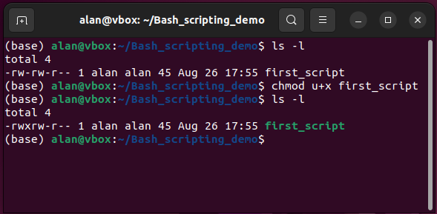
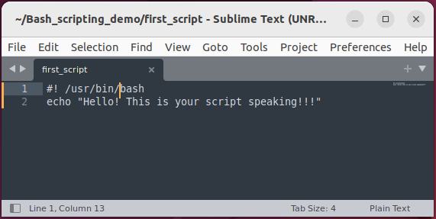
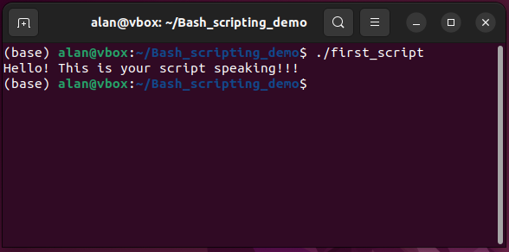
Running an executable script with a shebang
1
2
3

Slide 29
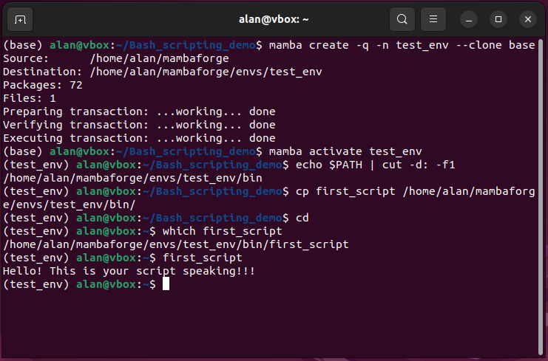
put your scripts on your path to run them anywhere

Slide 30
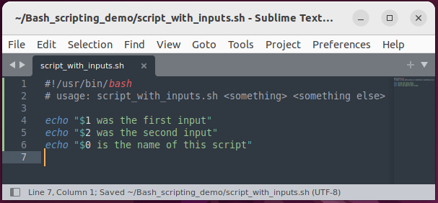
Comments and command line inputs
Characters following “#” are ignored by Bash – used as comments
Note: shebang is the exception
Positional arguments are stored in numbered variables. i.e., $1, $2, etc.
$0 refers to the script name
Script name is the first positional argument your shell gave to the interpreter specified in the shebang (or that you called)
For quick one-off scripts usage at the top can be easily found with head

Slide 31
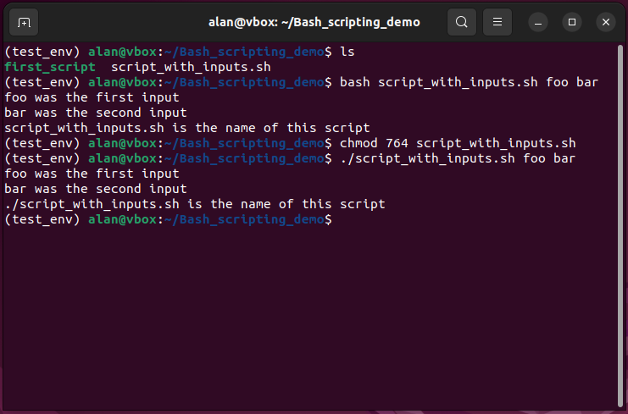
Command line input is used as variables in a script

Slide 32
End of Lesson

